Slide 1

Breast Cancer Diagnosis Using Machine Learning k Capstone Project
Setareh Homayoonnia
March 12, 2026

Slide 2
1- Problem & Goal of Product
• Breast cancer is one of the most common cancers worldwide • Early detection significantly improves survival rates • Diagnosis often requires expert analysis and can be time-consuming and error-prone
Goal
• Develop a machine learning model to classify tumors as benign or malignant using biopsy features

Slide 3
2. Dataset
Dataset: Breast Cancer Wisconsin Dataset
• 569 patient samples
Features include:
• Radius • Texture • Perimeter • Area • Smoothness
Target variable:
• Benign • Malignant

Slide 4
3. Machine Learning Workflow
Workflow Steps:
Data preprocessing
Feature scaling
Train-test split
Model training
Model evaluation
Final Model Selection

Slide 5
4. Technologies Used
Python
Libraries:
• NumPy • Pandas • Matplotlib • Scikit-Learn
Machine learning models:
• Logistic Regression • K-Nearest Neighbors (KNN) • Decision Tree • Neural Network

Slide 6
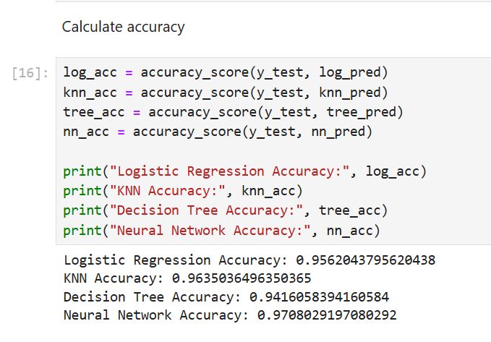
5. Model Evaluation Results
Accuracy
Accuracy was calculated for all models.
Neural Network achieved the highest accuracy, so it was selected for further evaluation.

Slide 7
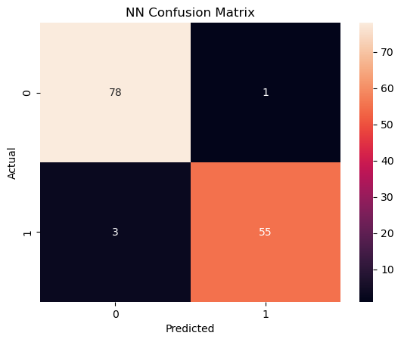
5. Model Evaluation Results
Confusion Matrix (NN Model)
True Negatives: correctly predicted benign tumors
True Positives: correctly predicted malignant tumors
Only a few cases were misclassified,
showing that the model performs very well.

Slide 8
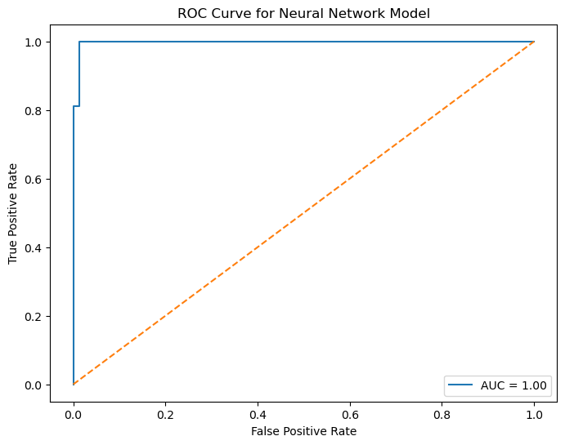
5. Model Evaluation Results
ROC curve (NN model)
The ROC curve shows the ability of the model to distinguish between benign and malignant tumors.
The AUC value is 1.00, which indicates excellent performance, meaning the model can separate the two classes very well.

Slide 9
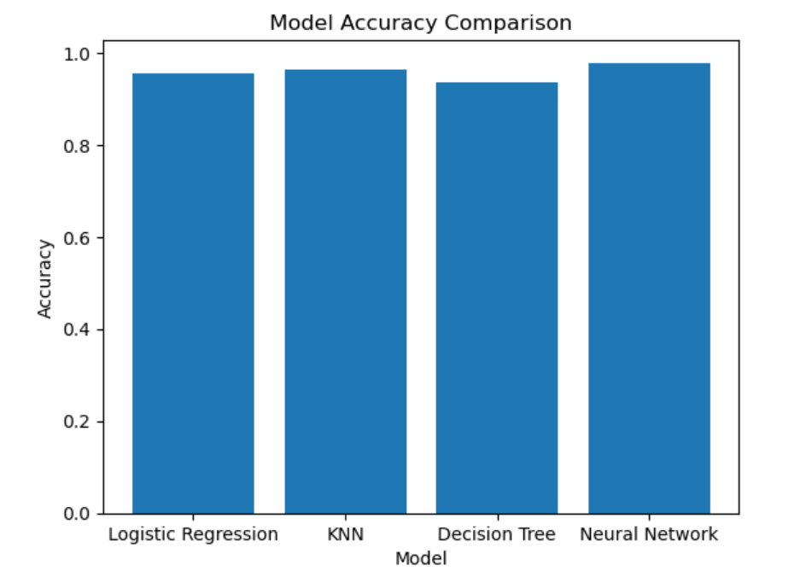
6. Final Model Selection
Neural Network showed the best overall performance
KNN also performed well
Logistic Regression and Decision Tree had lower accuracy
Neural Network selected as the final model

Slide 10
6. Challenges
• Selecting the most appropriate machine learning model
• Applying feature scaling for algorithms sensitive to feature magnitude
• Preventing overfitting using train-test split
• Comparing models using accuracy and performing detailed evaluation for the best model

Slide 11
7. Target Audience
Potential users:
• Hospitals and diagnostic centers • Medical laboratories analyzing biopsy samples • Healthcare technology companies developing diagnostic tools • Medical researchers working on cancer detection

Slide 12
8. Business Potential
Possible revenue models:
• Software licensing for hospitals and diagnostic centers • Integration into medical diagnostic platforms • Partnerships with healthcare technology companies
Value proposition:
• Faster and more efficient diagnosis • Decision support for doctors • Improved accuracy in cancer detection

Slide 13
Competitor / Existing Solutions
Current diagnosis methods
• Manual pathology analysis by medical experts • Traditional medical diagnostic software
Advantages of machine learning approach
• Faster data analysis • More consistent predictions • Decision support for medical professionals

Slide 14
Conclusion
Machine learning models can effectively classify breast cancer tumors and assist healthcare professionals in early diagnosis.
Key Outcomes
• Developed a machine learning model for breast cancer classification • Compared multiple machine learning algorithms • Neural Network achieved the highest accuracy
Future Improvements
• Use larger medical datasets • Apply deep learning techniques • Integrate the system into real clinical tools

